Slide 1

Linear Regression

Slide 2
Linear Regression
Linear Regression with OLS
Linear Regression with SGD
Assumptions
Evaluating Model Parameters
Polynomial Regression
Measuring Performance metrics-Lost and Cost Function (MAE,MSE,RMSE,R2 Score)
L1 and L2 Regularization
Cross Validation
Recap
Equation of line
Slop (M)
Basic integration xsn
Gradient descent
Differentiations
Maxima
Minima
Basic of ML
basic of Vector
basic of Linear algebra
matrix additions
transpose
dot product

Slide 3
Data Preparation and data preprocessing
Duplicate values
Missing values
Outliers
Feature engineering
Data encoding
Train test split
Train (train , validation) , why validations
Test
Data leakage
EDA
Model preparation
evaluation
Ml
Overfitting
Underfitting
Genralized model
Bias- variance trade-off
Variance
Bias

Slide 4
EDA and Preprocessing - AUTOMOBILE CARS
Basic EDA - Info, shape
Handling Missing Values
Handling Outliers
Handling Skewness
Categorical Data Encoding
Data Normalization or Scaling
Feature Engineering
https://scikit-learn.org/1.5/api/sklearn.datasets.html
https://github.com/mwaskom/seaborn-data
https://www.kaggle.com/datasets/burak3ergun/loan-data-set?resource=download

Slide 5
Basic EDA - Info, shape
df.info()
df.describe()
https://www.analyticsvidhya.com/blog/2022/07/step-by-step-exploratory-data-analysis-eda-using-python/

Slide 6
Handling Missing Values
df.isna().sum() # show the null values
df.dtypes
# replace the null with mean or median or anyvalue
df["Fuel_capacity"].fillna(df["Fuel_capacity"].mean())
# df['embark_town'] = df['embark_town'].fillna("Southampton")
df.dropna(inplace=True)
df.isna().sum()
df.duplicated().sum() # check duplicate
# drop duplicate
df.drop_duplicates(inplace=True)
https://www.analyticsvidhya.com/blog/2021/10/handling-missing-value/
https://www.geeksforgeeks.org/ml-handling-missing-values/

Slide 7
Handling Outliers
Q1 = df['Price_in_thousands'].quantile(0.25)
Q3 = df['Price_in_thousands'].quantile(0.75)
IQR = Q3-Q1
IQR
lower_fence = Q1-1.5*IQR
upper_fence = Q3+1.5*IQR
#dropping the outlier
df_filtered = df[(df.Price_in_thousands >= lower_fence) &
(df.Price_in_thousands <= upper_fence)]
import matplotlib.pyplot as plt
import seaborn as sns
df.columns
#To check outliers >> distplot, boxplot
plt.figure(figsize = (12, 5))
plt.subplot(1, 2, 1)
sns.histplot(df['Price_in_thousands'], kde = True)
plt.title("Dist plot")
plt.subplot(1, 2, 2)
sns.boxplot(data = df, x = 'Price_in_thousands')
plt.title("Box plot")
plt.show()
https://medium.com/analytics-vidhya/how-to-remove-outliers-for-machine-learning-24620c4657e8
https://www.analyticsvidhya.com/blog/2021/05/detecting-and-treating-outliers-treating-the-odd-one-out/

Slide 8
Handling Skewness
### Understanding the distribution of the column - __year_resale_value
sns.distplot(df['__year_resale_value'], label = 'Skewness: %.2f'%(df['__year_resale_value'].skew()))
plt.legend(loc = 'best')
plt.title('Distribution of the column - __year_resale_value')
import statsmodels.api as sm
from scipy import stats
https://machinelearningmastery.com/skewness-be-gone-transformative-tricks-for-data-scientists/
### Understanding the distribution of the data Box_Cox(__year_resale_value)
year_data = [1 if value == 0 else value for value in modified_dataset['__year_resale_value']]
modified_year, _ = stats.boxcox(year_data)
modified_dataset['__year_resale_value'] = modified_year
sns.distplot(modified_dataset['__year_resale_value'], label = 'Skewness: %.2f'%(modified_dataset['__year_resale_value'].skew()))
plt.legend(loc = 'best')
plt.title('Distribution of the column - __year_resale_value')

Slide 9
Categorical Data Encoding
#code to seprate numeric and categorical columns and store in DF.
cat_cols = [col for col in df.columns if df[col].dtype == 'object']
num_cols = [col for col in df.columns if df[col].dtype != 'object']
# [final_val for loop conditions ]
for col in cat_cols:
print(f"{col} has {df[col].nunique()} values\n")
from sklearn.preprocessing import LabelEncoder
label_encoder = LabelEncoder()
label_encoder.fit_transform(df[['status']])
#using pandas
pd.get_dummies(df['status'], drop_first=True, dtype = 'int')
from sklearn.preprocessing import OrdinalEncoder
df = pd.DataFrame({"qualification": ["HS", "PG","GR", "HS", "PhD", "HS", "PG"]})
encoder = OrdinalEncoder(categories = [["HS", "GR", "PG", "PhD"]])
encoder.fit_transform(df[['qualification']])

Slide 10
from sklearn.preprocessing import OneHotEncoder
encoder = OneHotEncoder()
encoder
encoded = encoder.fit_transform(df[['status']]).toarray()
encoder.get_feature_names_out()
### One Hot Encoding the columns - Manufacturer, Vehicle_type of the modified dataset
encoded_dataset = pd.get_dummies(data = modified_dataset, columns = ['Manufacturer', 'Vehicle_type'])
encoded_dataset
https://medium.com/anolytics/all-you-need-to-know-about-encoding-techniques-b3a0af68338b
https://www.analyticsvidhya.com/blog/2020/08/types-of-categorical-data-encoding/

Slide 11
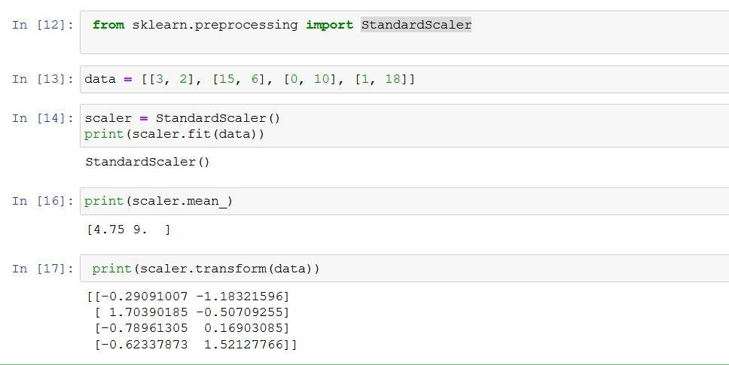
Data Normalization or Scaling
from sklearn import preprocessing
import numpy as np
x_array = np.array([2,3,5,6,7,4,8,7,6])
normalized_arr = preprocessing.normalize([x_array])
print(normalized_arr)
### A function to normalize numerical columns
def normalize_columns(dataframe, column):
data = dataframe[column]
mini = min(data)
maxi = max(data)
new_data = []
for value in data:
new_data.append((value - mini)/(maxi - mini))
dataframe[column] = new_data
numerical_columns = ['Sales_in_thousands', '__year_resale_value', 'Engine_size', 'Horsepower', 'Wheelbase', 'Width',
'Length', 'Curb_weight', 'Fuel_capacity', 'Fuel_efficiency', 'Power_perf_factor', 'Age']
for each_column in numerical_columns:
normalize_columns(modified_dataset, each_column)
scaler = preprocessing.MinMaxScaler()
d = scaler.fit_transform(california_housing.data)
The normalize() function scales vectors individually to a unit norm so that the vector has a length of one.
The default norm for normalize() is L2, also known as the Euclidean norm.
The L2 norm formula is the square root of the sum of the squares of each value.
Although using the normalize() function results in values between 0 and 1,
it’s not the same as simply scaling the values to fall between 0 and 1.
https://www.geeksforgeeks.org/ml-feature-scaling-part-2/
https://www.analyticsvidhya.com/blog/2020/04/feature-scaling-machine-learning-normalization-standardization/

Slide 12
Feature Engineering
Feature selection is the process of reducing the number of input variables when developing a predictive model. It is desirable to reduce the number of input variables to both reduce the computational cost of modeling and, in some cases, to improve the performance of the model.
# 4.6.1 Plotting the correlation matrix for the numerical columns
https://www.geeksforgeeks.org/ml-feature-scaling-part-2/
### Creating a filter_dataset
filter_dataset = encoded_dataset[['Sales_in_thousands', '__year_resale_value', 'Engine_size', 'Horsepower', 'Wheelbase',
'Width', 'Length', 'Curb_weight', 'Fuel_capacity', 'Fuel_efficiency', 'Power_perf_factor',
'Age']]
filter_dataset
https://www.analyticsvidhya.com/blog/2021/10/a-beginners-guide-to-feature-engineering-everything-you-need-to-know/
https://www.geeksforgeeks.org/what-is-feature-engineering/
### Plotting the correlation between various columns of the filter_dataset
plt.figure(figsize = (10, 10))
heatmap = sns.heatmap(filter_dataset.corr(), vmin = -1, vmax = 1, annot = True)
heatmap.set_title('Correlation Heatmap', fontdict = {'fontsize' : 12}, pad = 12)
# 4.6.2 Removing the columns that cause multicollinearity using VIF (optional)

Slide 13
Multi- coliniarity (Optional)
Where a feature exhibits a linear relationship withmore then one variable.
It never talk about x→y
It is x1 explain by x2 and x3
What → one feature explain by other feature.
Why → you can not intercept correctly what is the contributions of each indivisual feature w.r.t Y
It is no necessary → no affect on prediction
But it reduce complexity and computition time
Solution find Mulit coliniarirt by (VIF) variance Inflaction factor
Vif = 1/ 1-Ri-square → % variation in y explained by X
Vif 0 to infinite
2nd option RFE(Recursive Feature Elimanations ) when

Slide 14
### Detecting the columns that cause multicollinearity using VIF
column_names = list(filter_dataset.columns)
for name in column_names:
if len(column_names) >= 2:
Y = filter_dataset.loc[:, filter_dataset.columns == name]
X = filter_dataset.loc[:, filter_dataset.columns != name]
X = sm.add_constant(X)
linear_model = sm.OLS(Y, X)
results = linear_model.fit()
r_squared = results.rsquared
vif_value = round(1/(1 - r_squared), 2)
print("Column: {} and VIF: {}".format(name, vif_value))
if vif_value > 10:
filter_dataset = filter_dataset.drop([name], axis = 1)
column_names.remove(name)
#clustermap table shows group(cluster ) relationship
plt.figure(figsize = (5, 5))
sns.clustermap(df.corr(), vmin = -1, vmax =1, annot = True)
from statsmodels.stats.outliers_influence import variance_inflation_factor
vif = pd.DataFrame()
vif['Feature'] = df.columns
vif
vif["VIF"] = [variance_inflation_factor(df.values, i) for i in range(len(df.columns))]
Others methods
from sklearn.feature_selection import RFE
rfe = RFE(estimator = LinearRegression(), n_features_to_select=6)
rfe.fit(X, y)
rfe.support_
rfe.ranking_

Slide 15
Data Science
Data Analyst
Excel
Power BI/Tableau
Sql
Python
Data Engineer
Sql
Bigdata concept
Python
Pyspark
Machine Learning engineering
Sql
Basic maths
Python
DL engineering
Sql
Basic maths
Python

Slide 16
Linear Regression
Simple linear regression
One independent and one dependent (X,Y)
Y=mx+c
Error → (yactual – ypredicted)2
And when we need min error from all line
That is called OLS(ordinary Least square ) first basic model in linear regression
And when OLS divide by n (datapoints) then it it average of ols
And called it as cost funtions → MSE
So we optimiz the process of find MSE →using gradient descent
For Least error use 2 approach
1. Close form ax2+bx+c =0 (alfa ,beta)
2. itrative form (gradient solution)
So we observe increase m or decrease m error will change→ so we can say slope increase total error increase and slope decrease also total error increase.
So we want least error so slope =0 for minima in differentiation .
Using convergence algorithms
In machine learning, convergence is when a model's predictions stop improving and the error rate becomes constant. This means that the model has reached a stable state where it can make accurate predictions. Mnew =Mold –eta(or alpha rate /learning rate)D(CF)/Dold
https://www.analyticsvidhya.com/blog/2021/10/everything-you-need-to-know-about-linear-regression/

Slide 17
from sklearn.model_selection import train_test_split
X_train, X_test, y_train, y_test = train_test_split(X, y, test_size = 0.20, random_state = 111)
X_train
y_train
#visualised the result
plt.scatter(X_test, y_test, color = 'black', label = "Actual data")
plt.plot(X_test, y_pred, color = 'red', linewidth = 3, label = "linear regression line")
plt.xlabel("BMI")
plt.ylabel("One year preogression-target")
plt.title("My first linear regression model")
plt.legend()
plt.show()
#model training
from sklearn.linear_model import LinearRegression
model = LinearRegression()
model
model.fit(X_train, y_train)
model.coef_ #m, beta1
model.intercept_ #c, betanot
y_pred = model.predict(X_test)
X_test
y_pred
from sklearn.metrics import mean_squared_error, mean_absolute_error, r2_score
mean_squared_error(y_test, y_pred)
mean_absolute_error(y_test, y_pred)
r2_score(y_test, y_pred)#31% of y is explained by X, rquare 0 to 1
#adj rsquare = 1-(1-rsq)*N-1/n-p-1
score = r2_score(y_test, y_pred)

Slide 18
Multiple linear regression
More the 1 independent x variable.
Y not much extract all information from x so more accurate the data need more x’s require.
Equations
Cost funtions
Do same as simple regression no change
except you add more than one feature only

Slide 19
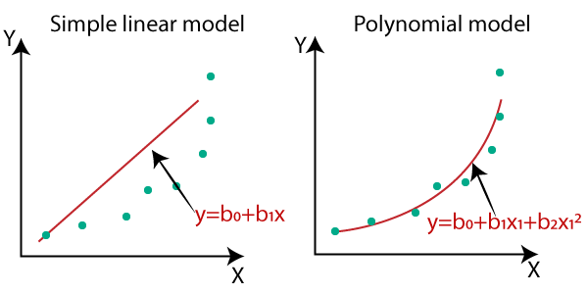
Polynomial Regression
Simple polynomial regression
Linear regression
1 independent and 1 dependent variable
polynomial Degree when 0
polynomial Degree when 1
polynomial Degree when 2
polynomial Degree when n
Use when the non linear relationship in variables (also another non linear models use like decision tree).
But as you increase the Degree, you might get an overfitting the model.
from sklearn.preprocessing import PolynomialFeatures
poly_regs= PolynomialFeatures(degree= 2)
x_poly= poly_regs.fit_transform(x)
lin_reg_2 =LinearRegression()
lin_reg_2.fit(x_poly, y)
Dis advantage
Model will be be overfitting
https://www.javatpoint.com/machine-learning-polynomial-regression

Slide 20
Regression Evaluation Metrics
MSE (also use as cost function/error function)
Error is quantifiable.
Lower the MSE better the model.
Advantage
disadvantage
RMSE
Root mean square errror
MAE
Less sensitive to outlier
More interpretable
It is same unit
R –square: =1- SSE/TSS → sse(Yactual – Ypredicted)2
R2 is the % variation in y explained by x.
Adjecent R-square
It penalize the r2 as we added more new feature
We add feature when the model diff in r2 and Adjusted r2 not more than 2-5%.
https://www.analyticsvidhya.com/blog/2021/05/know-the-best-evaluation-metrics-for-your-regression-model/

Slide 21
Assumptions of Machine Learning
Assumptions for Linear Regression
Linearity – x & Y should be linear in relationship
Observation are independents
Homoscedasticity → also know as constant variations , the variation of error is constant.
Normality in error →error will be normality distributed.
The feature should not be related → not among relations
https://www.analyticsvidhya.com/blog/2021/10/everything-you-need-to-know-aabout-linear-regression/

Slide 22
Overfitting ,underfitting https://www.simplilearn.com/tutorials/machine-learning-tutorial/overfitting-and-underfitting
train test and validate
validations for improve learning https://www.geeksforgeeks.org/training-vs-testing-vs-validation-sets/
Bias, Variance https://www.geeksforgeeks.org/bias-vs-variance-in-machine-learning/
bias-variance trade-off https://www.javatpoint.com/bias-and-variance-in-machine-learning
Genralized model https://www.analyticsvidhya.com/blog/2022/10/non-generalization-and-generalization-of-machine-learning-models/
Linear regression
yactual -y predict

Slide 23
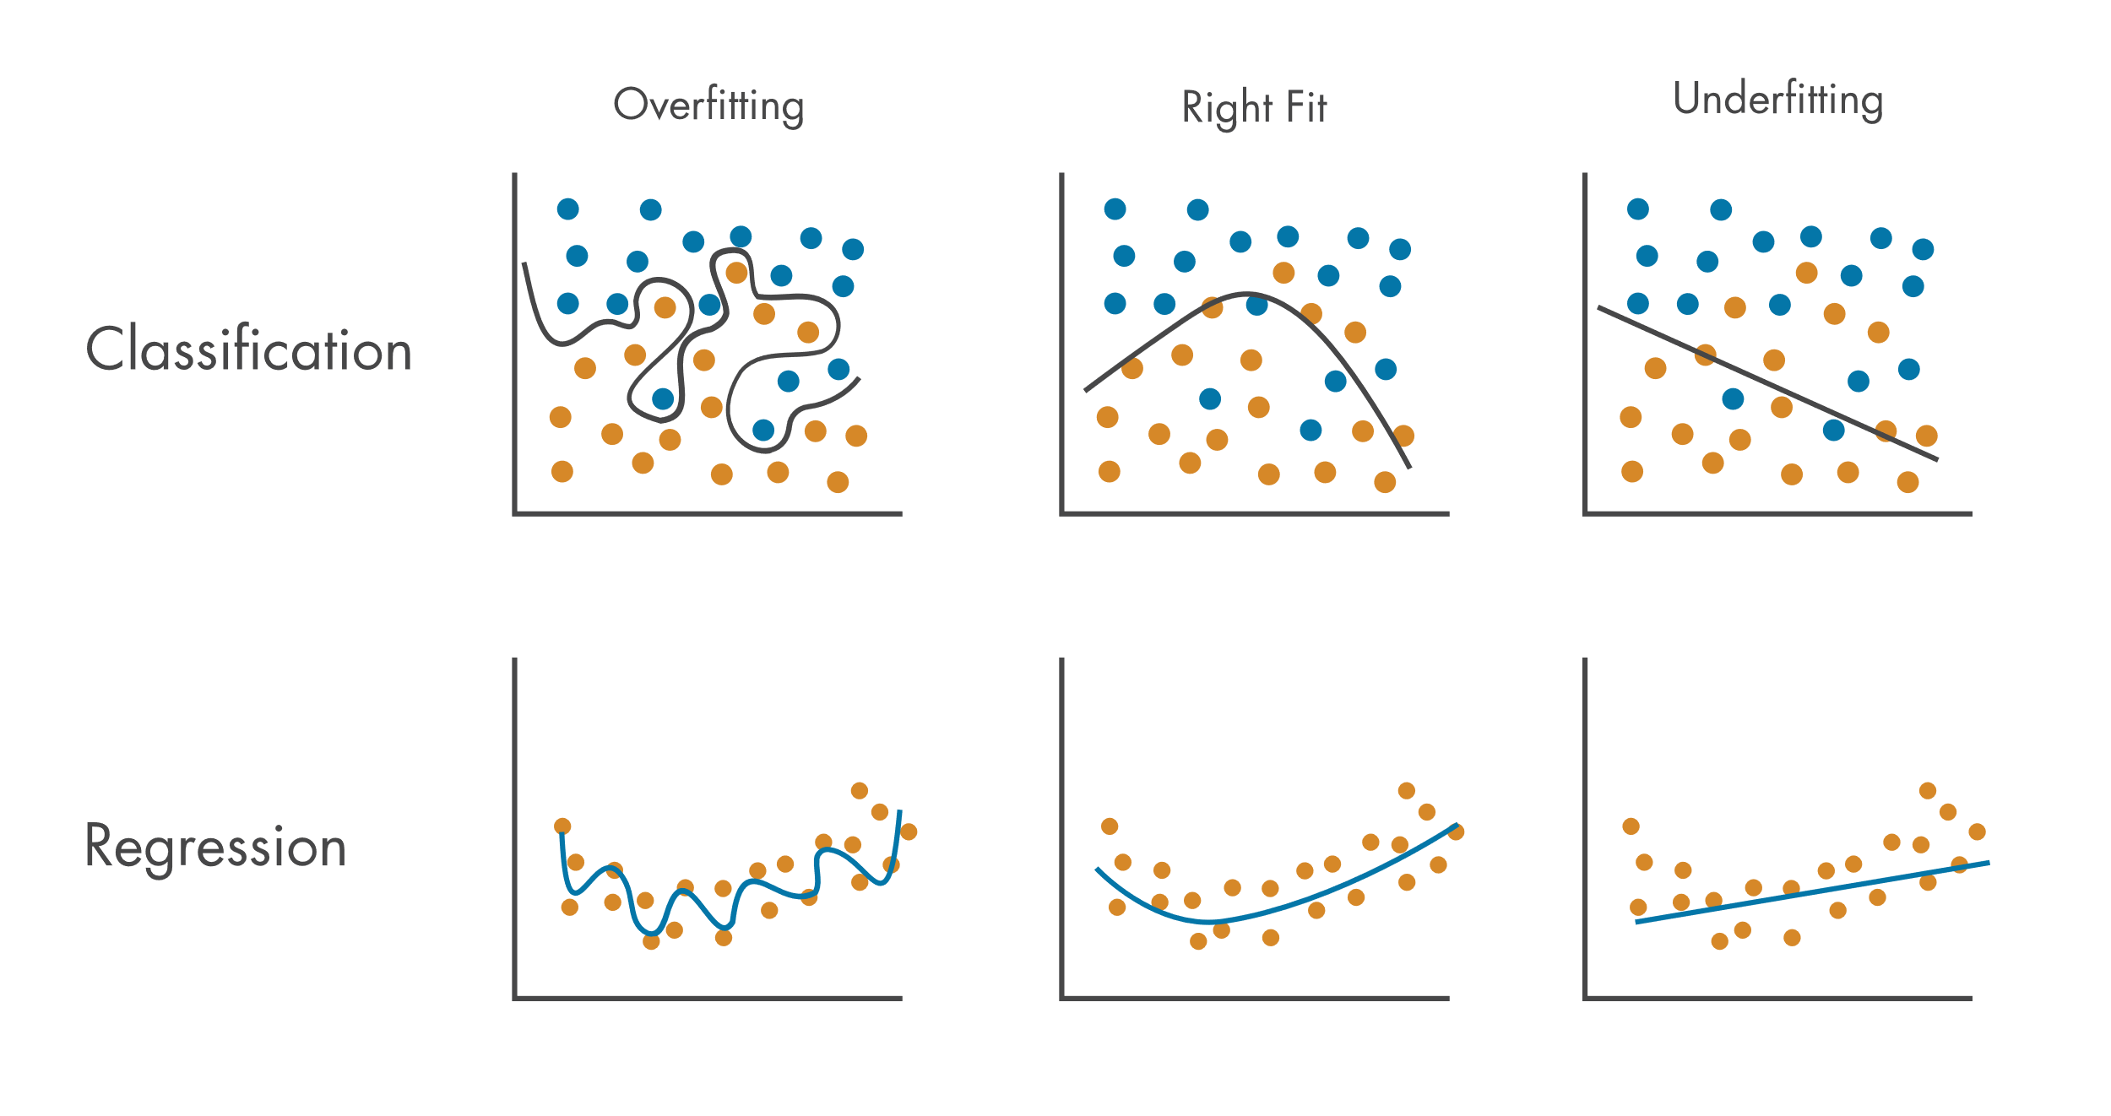
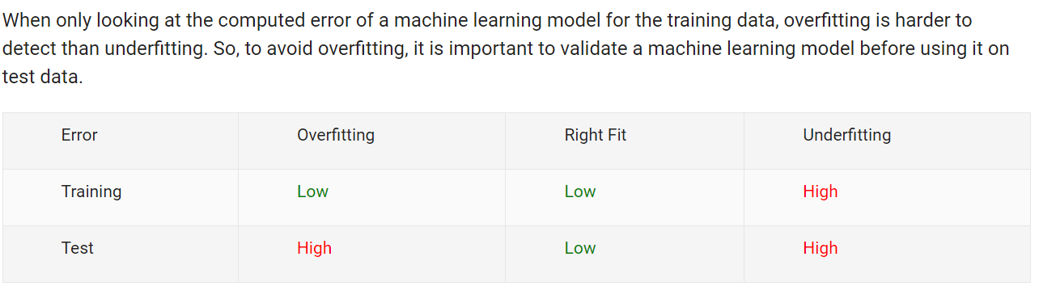
Overfitting underfitting
How to Avoid Overfitting by Reducing Model Complexity
1. Model Validation
2. Regularization
How to Avoid Overfitting by Enhancing the Training Data Set
1. Data Augmentation
2. Data Clean Up
https://www.mathworks.com/discovery/overfitting.html
Generalized Model
training Accuracy high
testing Accuracy high

Slide 24
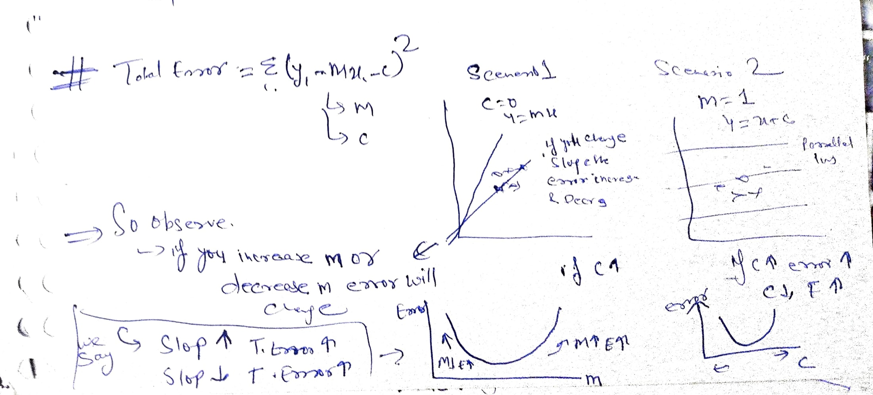
Least Error
total error --> MSE
error change when m and c change

Slide 25
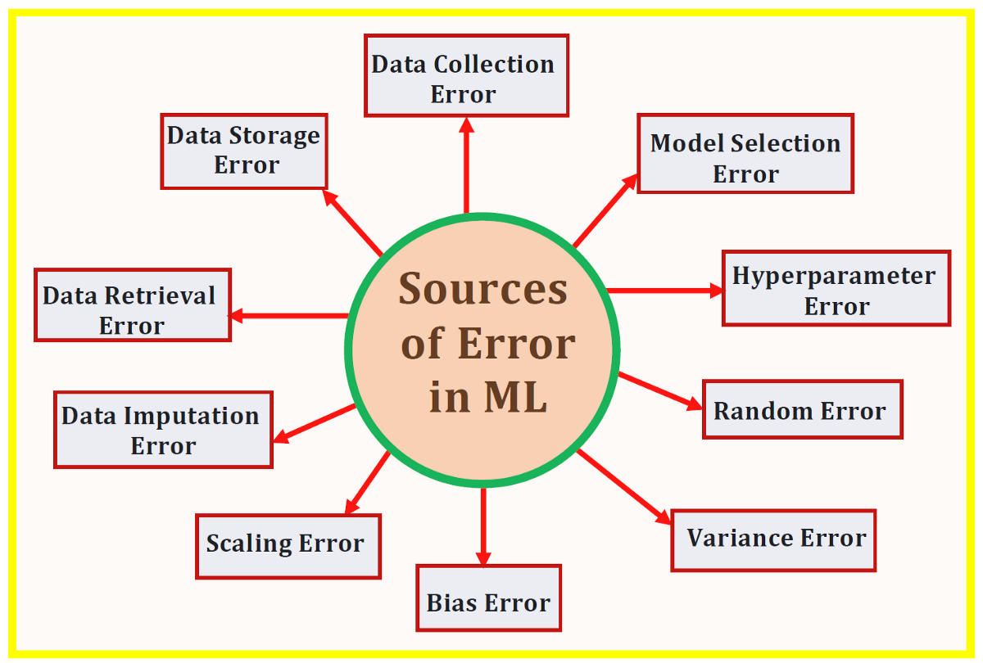

Slide 26
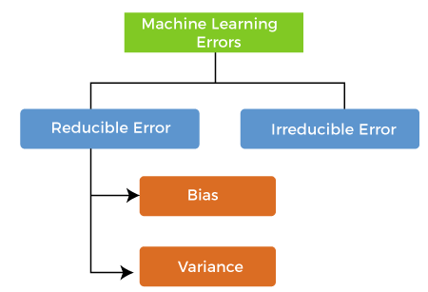
Bias
Variance
bias-variance trade-off
What is Bias?
training error is also known as bias.
high training error means high bias
What is Variance?
Testing error is also known as varience.
high testing error means high variance
https://www.javatpoint.com/bias-and-variance-in-machine-learning

Slide 27
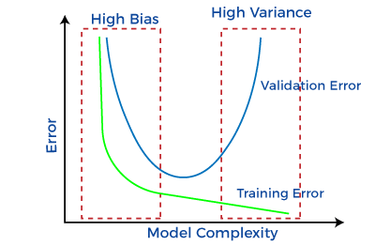
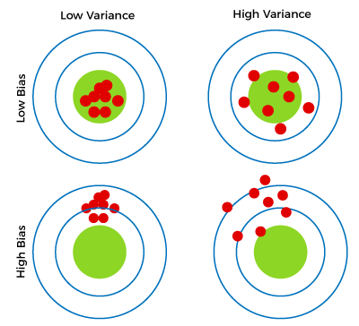
Red dots likely represent predictions (data points) made by the model.
Green circles represent the true values or the target outputs (the correct values the model should predict).
https://www.javatpoint.com/bias-and-variance-in-machine-learning

Slide 28
bias-variance tradeoff in machine learning:
Low Bias, Low Variance (Top Left):
The red dots (predictions) are clustered closely within the green circle (true value), indicating accurate and consistent predictions. The model is performing well, capturing both patterns in data with minimal error (low bias) and having consistent predictions across different training sets (low variance).
High Bias, Low Variance (Bottom Left):
The predictions (red dots) are grouped together but are far from the true value (green circle). This means the model makes systematic errors, possibly due to underfitting (high bias), but the predictions are still consistent (low variance).
Low Bias, High Variance (Top Right):
The red dots are scattered widely but are centered around the true value. The model captures the underlying data patterns well (low bias), but the high variance suggests that it is overfitting—predictions vary significantly with changes in the training data.
High Bias, High Variance (Bottom Right):
The red dots are far from the true value and are widely scattered. This model is both underfitting (high bias) and is inconsistent (high variance), indicating poor generalization and incorrect predictions.
In summary, the red dots show the accuracy and consistency of predictions, while the green area shows the true value or target. The four panels illustrate different combinations of bias and variance, highlighting the tradeoff between making systematic errors (bias) and sensitivity to fluctuations in the training data (variance).

Slide 29
To improve model 2 things do
1. Regularization
2. crossvalidation
Regularization https://www.javatpoint.com/regularization-in-machine-learning
To Add Some thing to regularisation / to penalize
Cost function
→ when m=0 ,yconstant →underfitting
→ when m is infinite → memorize the model and overfitting
So what we do m not 0 or not infinite so we find middle some →so add some error
By
1. Ridge regression /L2= CF+lambda*m-square
2. Lasso Regression/L1
ElasticNet = Ridge + lasso
https://www.simplilearn.com/tutorials/machine-learning-tutorial/regularization-in-machine-learning

Slide 30
#ridge regression
fromsklearn.linear_modelimportRidge
ridge_regression_model=Ridge(alpha=100)
ridge_regression_model.fit(X_train, y_train)
fori, col_nameinenumerate(X_train.columns):
print(f"The coefficient for {col_name} is {ridge_regression_model.coef_[i]}")
fromsklearn.linear_modelimportElasticNet
elastic_regression_model=ElasticNet(alpha=0.8, l1_ratio=0.4)
elastic_regression_model.fit(X_train, y_train)
fori, col_nameinenumerate(X_train.columns):
print(f"The coefficient for {col_name} is {elastic_regression_model.coef_[i]}")
#lasso regression
fromsklearn.linear_modelimportLasso
lasso_regression_model=Lasso(alpha=0.5)
lasso_regression_model.fit(X_train, y_train)
fori, col_nameinenumerate(X_train.columns):
print(f"The coefficient for {col_name} is {lasso_regression_model.coef_[i]}")

Slide 31
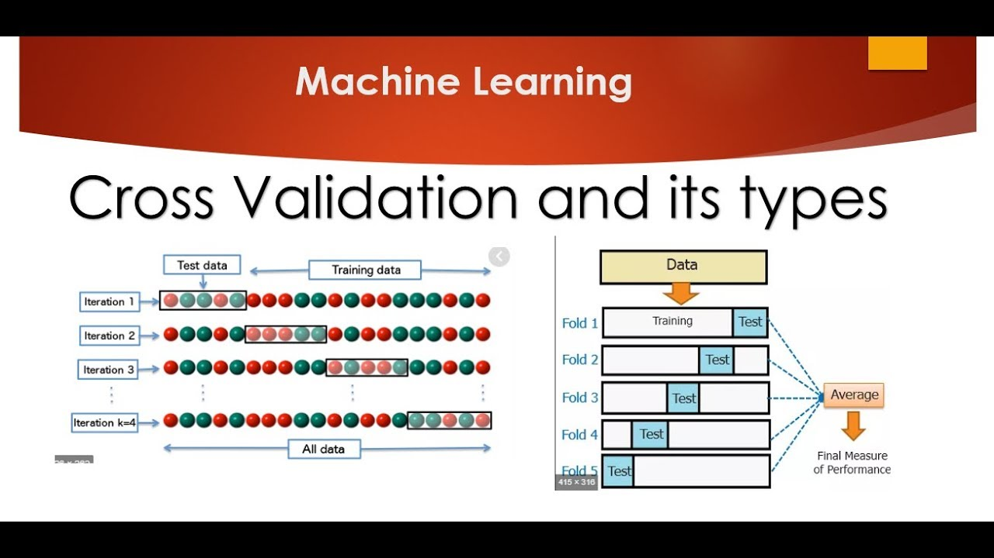

Slide 32

CrossValidation
“In simple terms, Cross-Validation is a technique used to assess how well our Machine learning models perform on unseen data”
According to Wikipedia, Cross-Validation is the process of assessing how the results of a statistical analysis will generalize to an independent data set.
Cross-Validation is a resampling technique with the fundamental idea of splitting the dataset into 2 parts- training data and test data. Train data is used to train the model and the unseen test data is used for prediction. If the model performs well over the test data and gives good accuracy, it means the model hasn’t overfitted the training data and can be used for prediction.
Types
Hold out method
Leave One Out Cross-Validation
K-Fold Cross-Validation
Stratified K-Fold Cross-Validation
Bias – Variance Tradeoff
sklearn.model_selection
has a method cross_val_score which simplifies the process of cross-validation.
https://www.analyticsvidhya.com/blog/2021/05/4-ways-to-evaluate-your-machine-learning-model-cross-validation-techniques-with-python-code/

Slide 33
k-fold CV:
from sklearn import datasets
from sklearn.tree import DecisionTreeClassifier
from sklearn.model_selection import KFold, cross_val_score
X, y = datasets.load_iris(return_X_y=True)
clf = DecisionTreeClassifier(random_state=42)
k_folds = KFold(n_splits = 5)
scores = cross_val_score(clf, X, y, cv = k_folds)
print("Cross Validation Scores: ", scores)
print("Average CV Score: ", scores.mean())
print("Number of CV Scores used in Average: ", len(scores))

Slide 34
Stratified K-Fold
In cases where classes are imbalanced we need a way to account for the imbalance in both the train and validation sets. To do so we can stratify the target classes, meaning that both sets will have an equal proportion of all classes.
from sklearn import datasets
from sklearn.tree import DecisionTreeClassifier
from sklearn.model_selection import StratifiedKFold, cross_val_score
X, y = datasets.load_iris(return_X_y=True)
clf = DecisionTreeClassifier(random_state=42)
sk_folds = StratifiedKFold(n_splits = 5)
scores = cross_val_score(clf, X, y, cv = sk_folds)
print("Cross Validation Scores: ", scores)
print("Average CV Score: ", scores.mean())
print("Number of CV Scores used in Average: ", len(scores))

Slide 35
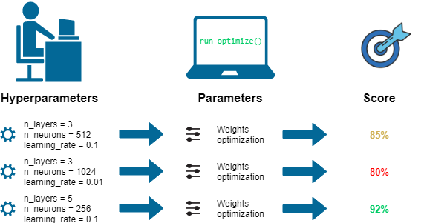
Hyperparameters
As we know that there are parameters that are internally learned from the given dataset and derived from the dataset, they are represented in making predictions, classification and etc., These are so-called Model Parameters, and they are varying with respect to the nature of the data we couldn’t control this since it depends on the data. Like ‘m‘ and ‘C‘ in linear equation, which is the value of coefficients learned from the given dataset.
Some set of parameters that are used to control the behaviour of the model/algorithm and adjustable in order to obtain an improvised model with optimal performance is so-called hyperparameter tuning in machine learning.
https://www.analyticsvidhya.com/blog/2022/02/a-comprehensive-guide-on-hyperparameter-tuning-and-its-techniques/

Slide 36
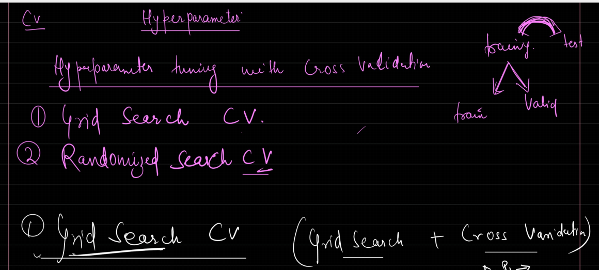
https://www.analyticsvidhya.com/blog/2022/02/a-comprehensive-guide-on-hyperparameter-tuning-and-its-techniques/

Slide 37
Model predicitions
https://www.analyticsvidhya.com/blog/2021/04/steps-to-complete-a-machine-learning-project/
GRADIENT DESCENT
https://www.geeksforgeeks.org/gradient-descent-algorithm-and-its-variants/

